Slide 1
Grants and Funding
Dressage NSW Clubs Online Forum 2023
Jenny Carroll & Debbie Eisenhauer-Rodney

Slide 2
Grants Sources
Federal and state government
Local government
Business
Sport
Philanthropy groups

Slide 3
Types of Grants
100% donation
Percentage support from applicant
Interest free loan
Tied to products/services
Require partnerships with other organisations

Slide 4
Think strategically
Some grants are staged, eligibility for stage 2 is based on outcomes of stage 1 projects (eg heritage grants)
Some may be more general community welfare – can participation give you a profile for other opportunities (eg post flood community grants)?
Some require links with other groups or councils – have you already made connections that can help in the future (eg local council sport)?

Slide 5
Preparing your application
Read the grant documents
What is the purpose of the grant?
What types of organisations are eligible?
Not for profits?
Charities?
Small business?
Councils?
Clubs?
What information is required in the grant application?
Support from other organisations?
Business structure/bank accounts/ATO profile?
Project staff?
Apply Here
⬇

Slide 6
Questions to ask as you prepare your application
Who is your organisation?
What do you want to do?
What evidence do you have that it is needed/can be achieved?
What do you expect to achieve, what is the impact of the activity on the wider community?
What innovations will it provide?
How much will it cost?
How much do you want from the grant?
What will your organisation contribute towards the cost?
How long will the project take?
When will you start/finish?
How will you measure success?

Slide 7
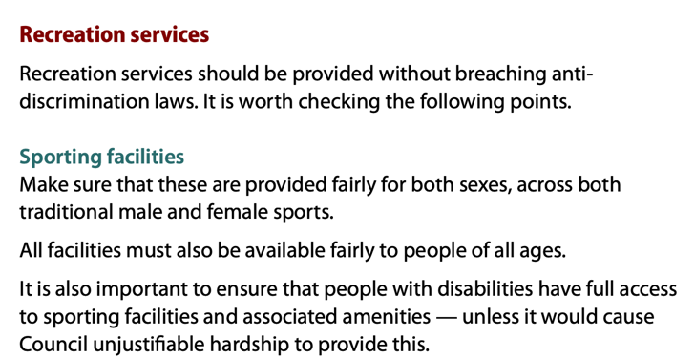
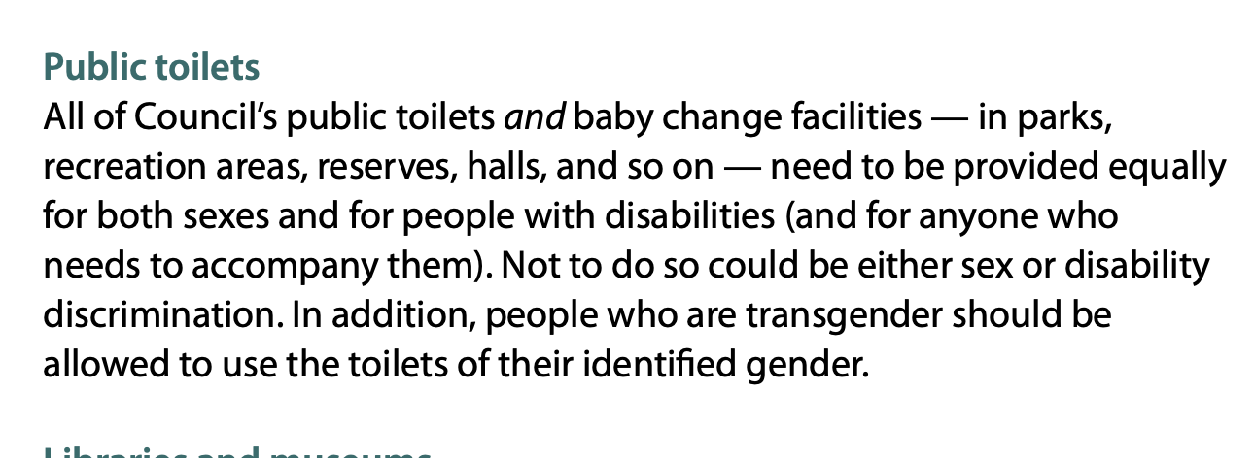
Do your homework: an example
What is the local government disability action plan?
The Disability inclusion Act requires all local government organisations to produce a Disability Inclusion Action Plan (DIAP) setting out measures enabling people with a disability to access general support and services and fully participate in the community.

Slide 8
Tips for Success
Read the guidelines | You won’t be funded for something that is not part of the funding objectives
Get support from others for your idea | Letters of support/joint applications
Develop a realistic budget (but that doesn’t mean you have to be modest) | Remember that timeframes, costs have to be appropriate – assessors do know what items are worth
Ensure you can meet the grant requirements | Reporting, recording spending of grant funds, providing notice if plans change are essential, have someone responsible for this being done
Review and submit your application on time | Many grants use online forms now so check what is required on the form well before the deadline
If successful re-read your obligations | Templates for reporting, deadlines are usually required but check for other requirements

Slide 9
Grant links
Austrade | https://www.austrade.gov.au/australian/tourism/grants-and-support-for-tourism-businesses
Australia Post | https://auspost.com.au/about-us/supporting-communities/grants/community-grants-program
Community grants | https://www.communitygrants.gov.au/
Federal Government Grants | https://business.gov.au/grants-and-programs?resultsNum=10
Grain Corp Grants | https://www.graincorp.com.au/community-fund/
NSW Government | https://www.nsw.gov.au/waratah-research-network/grants-and-funding-opportunities
Sport Access Grants | https://www.sportaccessfoundation.org.au/what-we-do/who-can-apply
Sport NSW Grants | https://www.sport.nsw.gov.au/grants
Way Ahead | https://mentalhealthmonth.wayahead.org.au/grant-questions/?fbclid=IwAR214GpZMg8wLjau4JR9-25mRjZE_6jxa3hzZnwQa-oFrdhcnjrBt6lij4M

