Slide 1
Stewarding Requirements in 2024
2023 Club Forum

Slide 2
New Dressage Rule in 2024
All Official Competitive Dressage events will require an Officially EA Accredited Dressage Steward to be in attendance from 1st January 2024

Slide 3
Purpose of stewarding
It is the supervision of events by trained individuals to ensure that the welfare of the horse is paramount and that a level playing field is provided for all athletes participating at the event.
Support the organising committee in managing the event
EQUESTRIAN AUSTRALIA POWRPOINT PRESENTATION

Slide 4
Event Team/teams
Organising Committee
Stewards
Competitors
Ground Jury
Volunteers
Venue Management

Slide 5
Stewards have an Education Pathway

Slide 6
Prerequisites to fulfil Steward accreditation requirements
All candidates must attain or show competency in the following prerequisites prior to being accredited as a:
Steward – Level 1:
• at least 18 years of age
• Current EA Membership
• Attendance at EA Generic & Discipline Specific Level 1 Steward Course
• Completion Risk Management Task
• Generic and Discipline specific ORBT, with a pass mark of 80%
• Personal fitness level that will enable them to physically complete the practical requirements of the course, and the duties required of an EA Steward
• Completion of ASC online Community Officiating General Principles www.sportaus.gov.au/coaches_and_officials/officials
• Pass assessments of Shadowing Steward Practical Activities 1 & 2 (with FEI Steward over 2 days)

Slide 7
Stewards are trained in:

Slide 8
Stewards are knowledgeable in:

Slide 9
Stewards are knowledgeable in:
Including Event Management

Slide 10
Stewards are knowledgeable in: Tack & Equipment Requirements

Slide 11
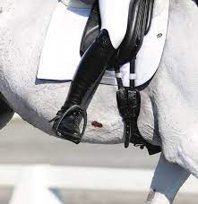
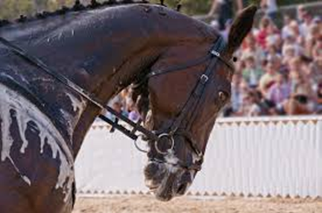
Stewards are trained in: Recognising horse welfare issues

Slide 12
Current Steward Distribution NSW
Northern NSW 1 steward
Stewards in Training
= 15
Northern Rivers 2 Stewards
New England 3 Stewards
Hunter 7 Stewards
Syd Metro 10 Stewards
South West 5 Stewards
Central West 2 Stewards
Sthn Highlands 2 Stewards
South Coast 1 Steward

Slide 13
Currently 33 Dressage Stewards in NSW (+ 15 in training)
Steward Training is a Priority in both Metro and Regional NSW
It’s time for action
Approx, 140 Official events were held 2023 in NSW

Slide 14
Apply to run a course to DNSW admin
Cost $3500-$4500 per course
Funding may be available

